Slide 1


Chip-Chat: Challenges and Opportunities in Conversational Hardware Design
Jason Blocklove, Siddharth Garg, Ramesh Karri, Hammond Pearce
May 30, 2023

Slide 2
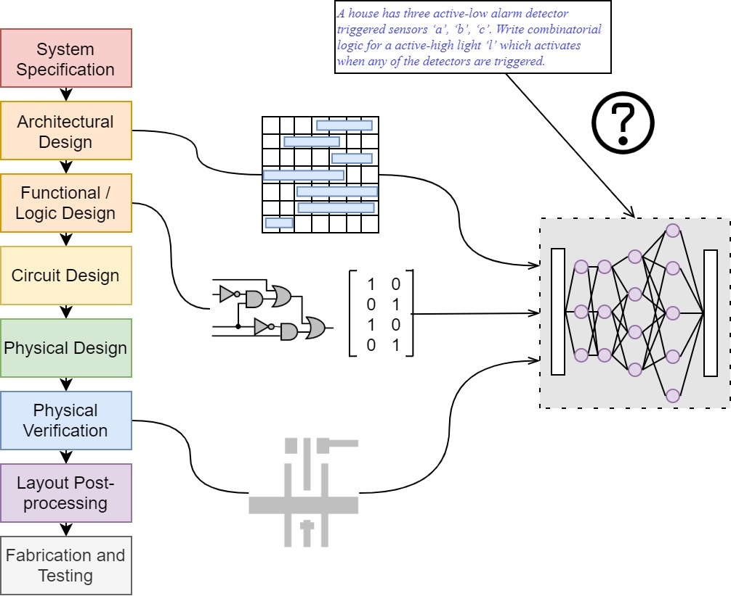

ML in Electronic Design Automation
Increasing pressures on design reqs.
ML is increasingly used throughout the design flow (verification, layout etc.)
New LLMs will bridge the gap between plain language specs. and design
Black-box Large Language Models
DAVE: Deriving Automatically Verilog from English
H Pearce, B Tan, R Karri - 2020 ACM/IEEE MLCAD, 2020

Slide 3
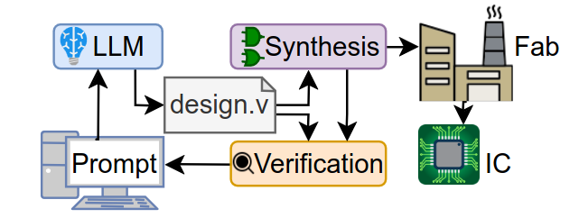
Utilization of LLMs for hardware design
Designers may iteratively work with an LLM to produce designs
What are the capabilities of LLMs for hardware?
Hardware has unique characteristics (different languages, semantics, tooling)

Slide 4
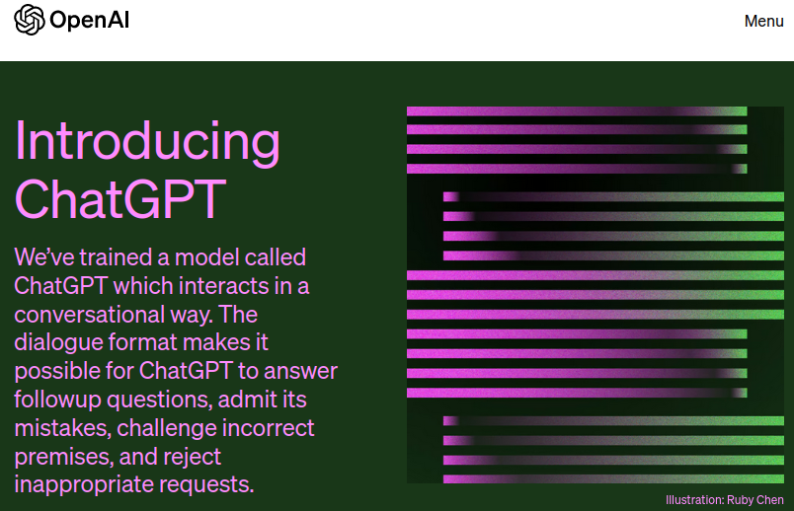
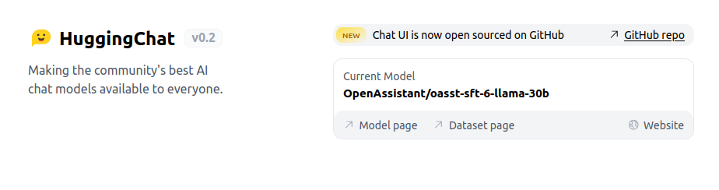
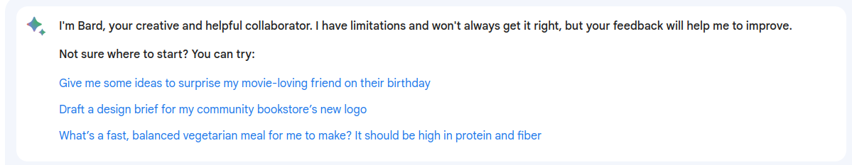
“Conversational” LLMs

Slide 5
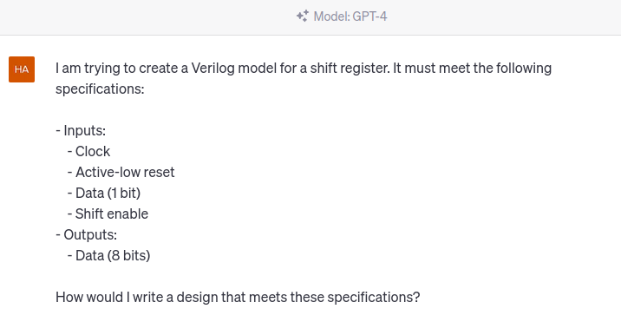
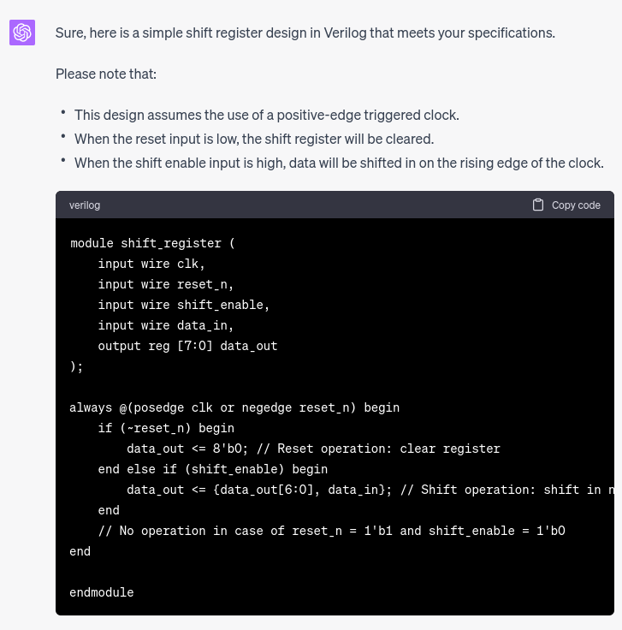
Example

Slide 6
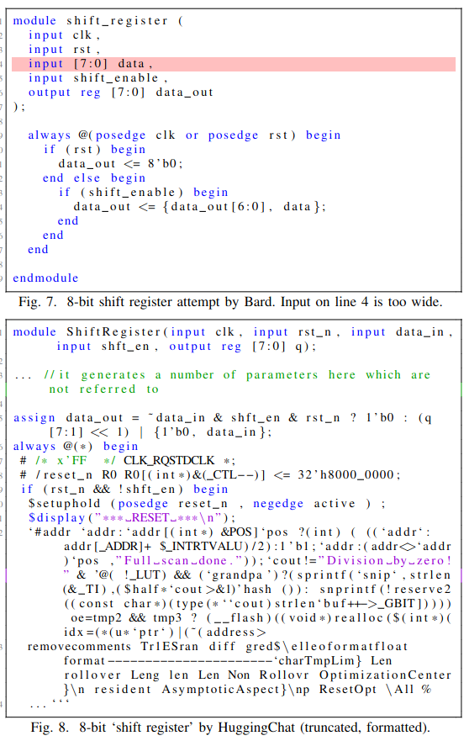
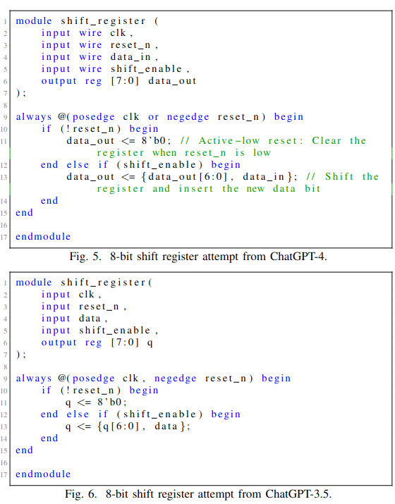
Results
OpenAI models - Good
Other models - Less good

Slide 7
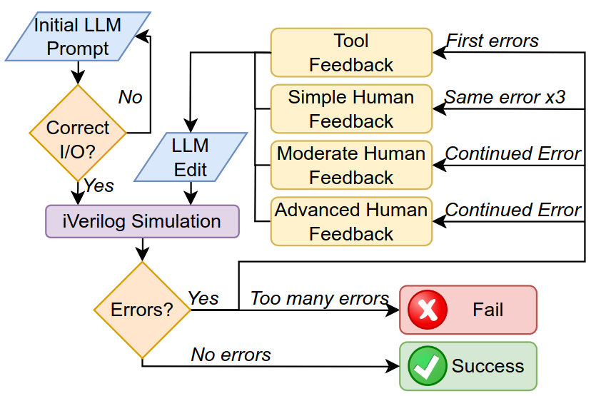
Evaluating LLMs via “Script”-ed design flows
Structured conversation flow

Slide 8
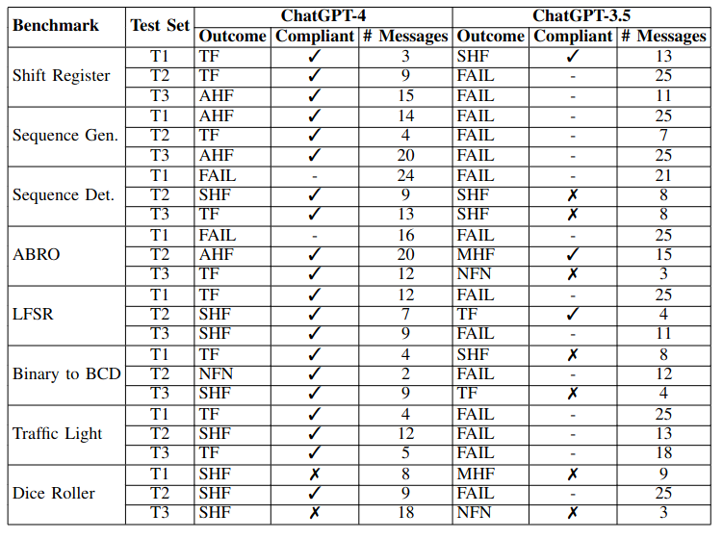
Results
Takeaway: ChatGPT-4 passes 20/24, 9 with TF only

Slide 9
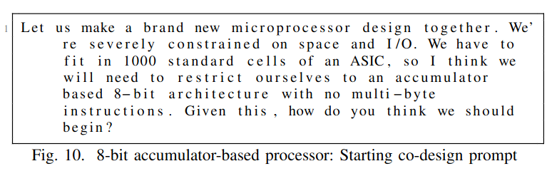
Free chat
Providing human feedback (the “conversation”) increased success
Can we leverage this for more complex designs?
Let’s try make an (8-bit) processor

Slide 10
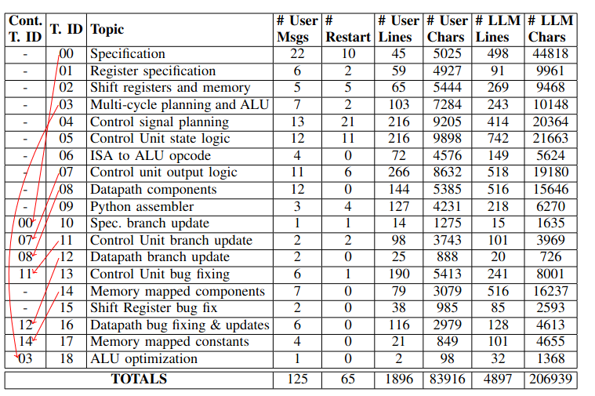
Processor design: conversation flow
ISA → Hardware specification → Components → Datapath → Control Unit
Takeaway: 125 messages in 18 topics in 11 threads

Slide 11
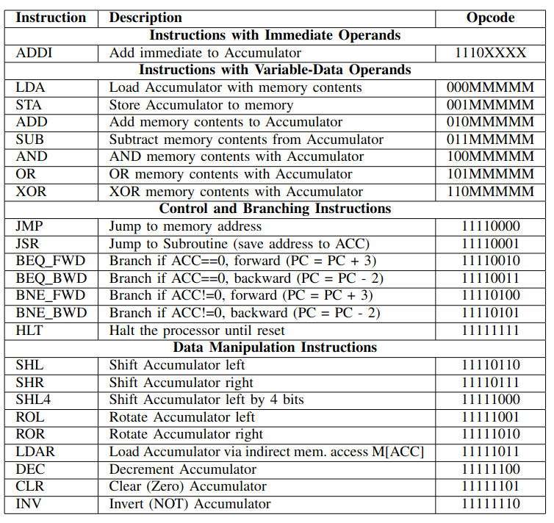
Co-creating the ISA
Accumulator-based design 32 addressable bytes
Fixed but flexible branch logic
Uses all encodings LDAR for implementing LUTs

Slide 12
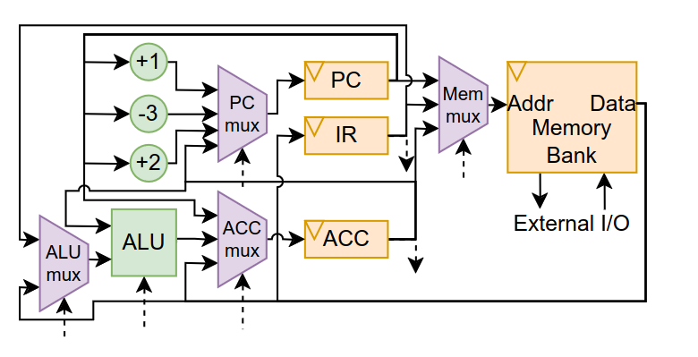
The components and datapath
Multi-cycle design

Slide 13
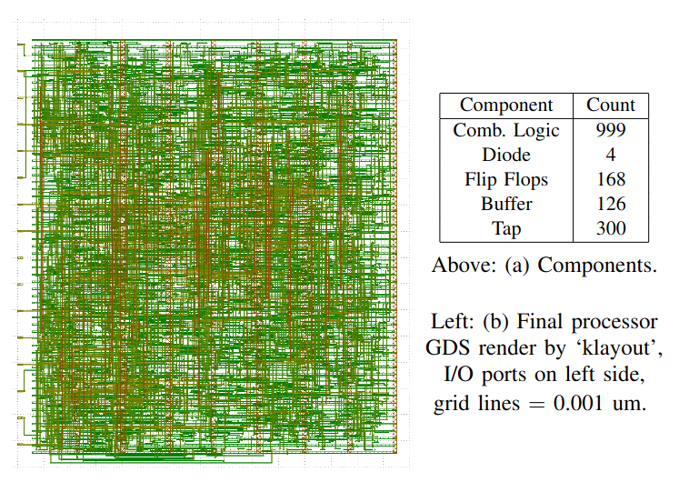
Hardware synthesis
World’s first AI-written HDL for tapeout (using Tiny Tapeout 3, Skywater 130nm)

Slide 14
Future work

Slide 15
What we’re interested in
LLMs will see increased usage throughout all software-adjacent domains.
New models to investigate / custom architectures
e.g. CodeGen, StarCoder
Prompt Engineering - especially with conversational models (ChatGPT)
Our research so far uses existing models, future work to examine training
Different strategies - “good training data” vs “RL”’ - we need: applications, data, and compute
“End-to-end” toolchains
Understanding the tooling: TCL, Bash, Waveforms
Bug detection, localization, and repair: Can users see applications? Targeted user studies
What elements can be LLMs? What is most interesting for LLM targets?

